Slide 1

EHR
(Electronic Health Record)
Xuanbo (Eddie) Yu
Quan (Coco) Yuan
Chen (Lillian) Xie

Slide 2
TABLE OF CONTENTS
01
02
03
BACKGROUND
Current Inefficiencies
EHR as a Solution
Competitive Analysis
EHR IMPLEMENTATION
Sustainability
Features and Improvements
THE FUTURE
Future Trends of EHR

Slide 3

Background
Current Inefficiencies
EHR as a Solution
Competitive Analysis
SWOT

Slide 4
Inefficiencies of Traditional Paper-based Health Records
High Cost
Low Efficiency
Insecurity
Consumed a great amount of space
Storage scale-up is difficult and costly
Significant cost on office supplies
High HR cost in file compiling, maintenance and archiving
Unstructured texts slow down information extraction process
Poor readability & possibility of misinterpretation
Time-consuming physical handling procedures
Prone to damages
Lack of backups
Weak protection that may leads to data leakage

Slide 5
Expectations on Health Record
Cost Reduction
Efficiency Improvement
Legitimate Authority & Enhanced Safety
Technology
Advancement

Slide 6

The Birth of Electronic Health Record
An Electronic Health Record (EHR) is an electronic version of a patient’s medical history
Began in the 1960s and ’70s, medical centers started developing their own systems
2004, the government encouraged all health care providers to adopt EHR
EHR is an all-round system designed for health-care organizations to improve sales process between patients and health provider
Its features include CRM, sales, and management features, etc.
The electronic health records market is expected to garner a market value of $ 6.78 billion in 2022, and reach a value of $41.8 billion in 2032

Slide 7


Epic Systems Corporation(Epic) is an American privately held healthcare software company

Slide 8
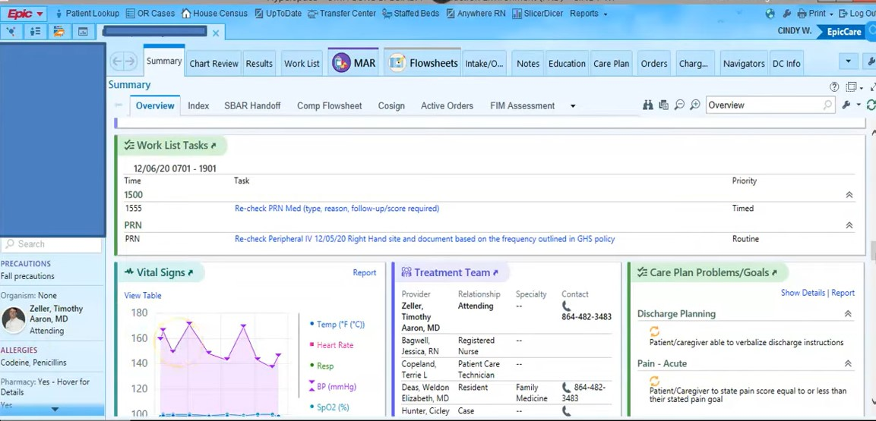
Interface
Image: https://www.emrsystems.net/epic-ehr-software/
Notes:
https://www.emrsystems.net/epic-ehr-software/

Slide 9
Epic: Introduction
Company Background
Founded in 1979, Epic Systems Corporation is headquartered in Verona, Wisconsin.
Epic is a cloud-based EHR built for mid-size and large medical groups, hospitals and integrated healthcare organizations with the functionality to handle the day-to-day operations of a practice, including patient medical records. The typical cost of Epic’s EHR is around $1200-$500,000 per year.
Scale
Epic is so far the most preferred electronic medical record system used by more than 250 health care organizations nationwide. To date, according to the company, hospitals that use its software held medical records of 78% of patients in the United States and over 3% of patients worldwide. In total of 289,442,362 record exchanges have been conducted through Epic until May 2022.

Slide 10


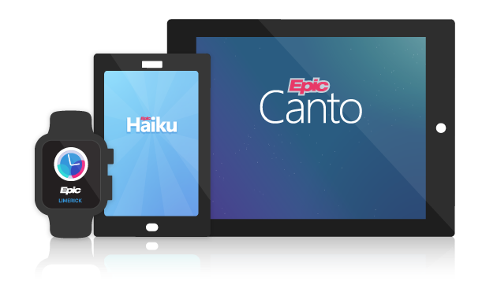
Epic: Products and Services
Patient portal: Mychart
Clinical tool: EpicCare
Speciality care: Different modules
Telehealth: specialist referral services, patient monitoring, consultation, etc.

Slide 11
Main Competitors
 | Epic | Cerner | Meditech | Allscripts
Overall Service
Clinical Workflow & Patient Health Information Management
Key Features | Technology AI Enterprise Software Telehealth Healthtech | Technology Cloud Telehealth IT services Platform | Technology Automation Data Management IT services Platform | Technology Automation Data Management IT services Medical Records
Revenue | $5.75B(2021) | $5.8B(2021) | $493.8M(2019) | $1.5B(2021)
Market Share (2022.6) | 36.92% | 22.59% | 14.09% | 4.01%

Slide 12
Epic: SWOT
Strength
Weakness
- Largest market share (36.92%) & large customer base
- Integrates easily with Epic Practice Management solution
- Reputation for having a good customer service
- Product starting price is higher than competitors on average
- Complicated to use at the beginning
- Imposes too much discipline on employees
Opportunity
Threats
- Access to large health statistics enables complicated research
- Smooth workflow for healthcare organization
- Payment and tax refunds
- Resistance to adopt: requires effective & rational training standards
- New players rushing into the market

Slide 13

EHR Implementation
Epic Implementation At Stanford Hospital And Clinics
Epic At Gundersen Lutheran Medical Center

Slide 14
EHR Sustainability
User Switching Costs
 | Paper-Based Record to EHR | Switching between EHRs
Healthcare Organizations/ Healthcare Providers | High adoption costs: Large amount of data transferring work Employee training during EHR adoption The long-term benefits outweigh the initial costs | Extremely high costs: EHR is customized and organization-specific Switching between EHR system is rare due to tremendous switching costs
Patients | Low costs: Minimum amount of patient education about how to access EHR from the patient portal
High Barrier to Entry for Competitors

Slide 15

Epic Implementation at SHC
EHR investment shortage
Update gap of $60 million
Current CPOE* system is unable to standardize order sets and work processes leading to operational inefficiencies
SHC‘s current system is far behind competitors
15%-20% of US physician offices and 20%-25% of hospitals have implemented EHR (2005)
SHC finally spent $150 million to implement Epic's EHR system
Image: https://www.crunchbase.com/organization/stanford-hospital-clinics/people
*CPOE: A system help transform health care delivery, align financial incentives to support population health management and build the workforce needed as health care moves to value-based care.

Slide 16
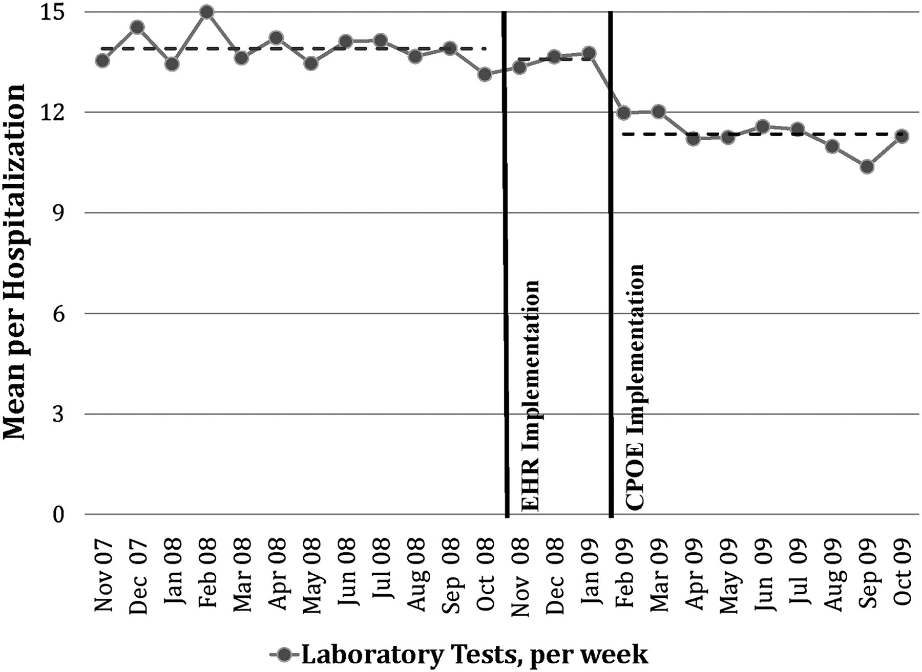
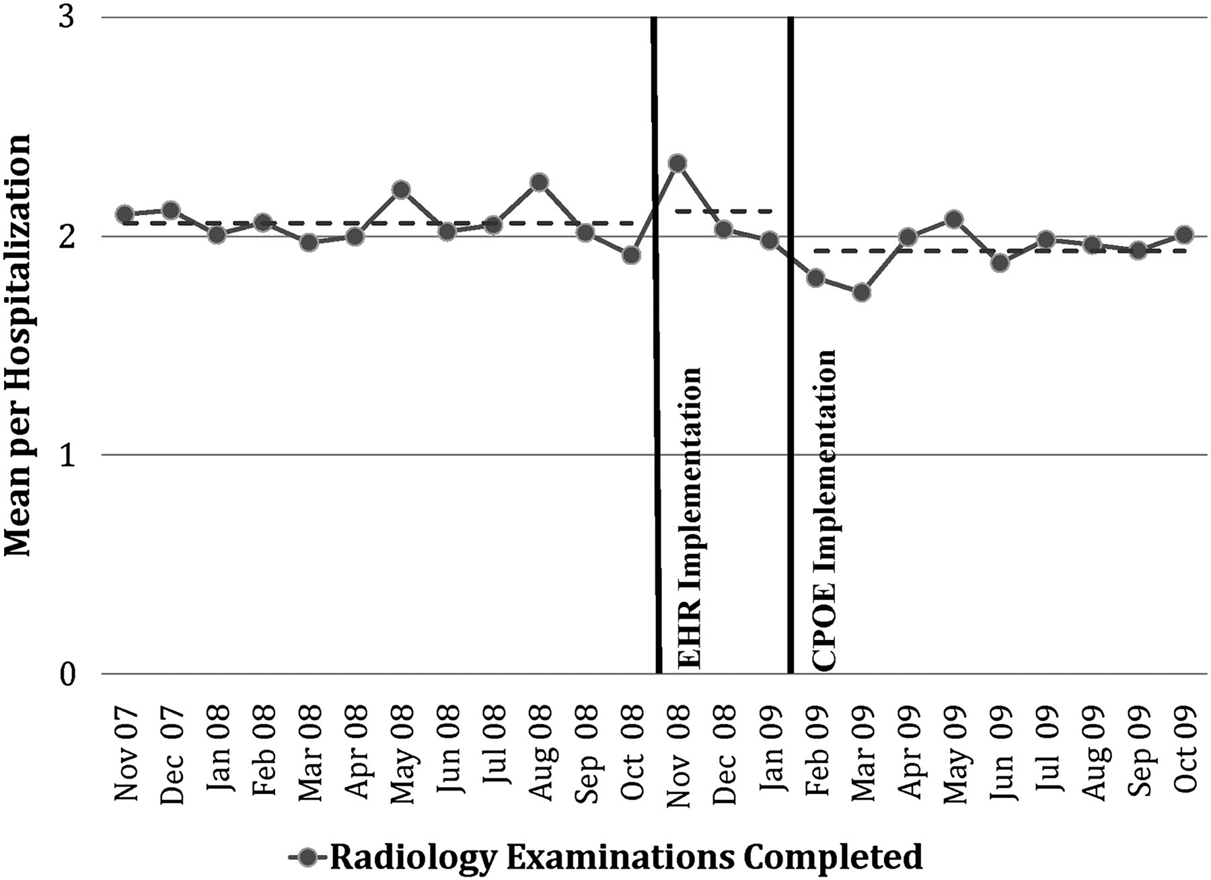

Epic at Gundersen Lutheran Medical Center
Simplify the process
Laboratory tests per week per hospitalization decreased from 13.9 to 11.4 (18%; p<0.001).
Radiology examinations per hospitalization decreased from 2.06 to 1.93 (6.3%; p<0.009).
https://www.gundersenhealth.org/
our-system/news/logos/

Slide 17
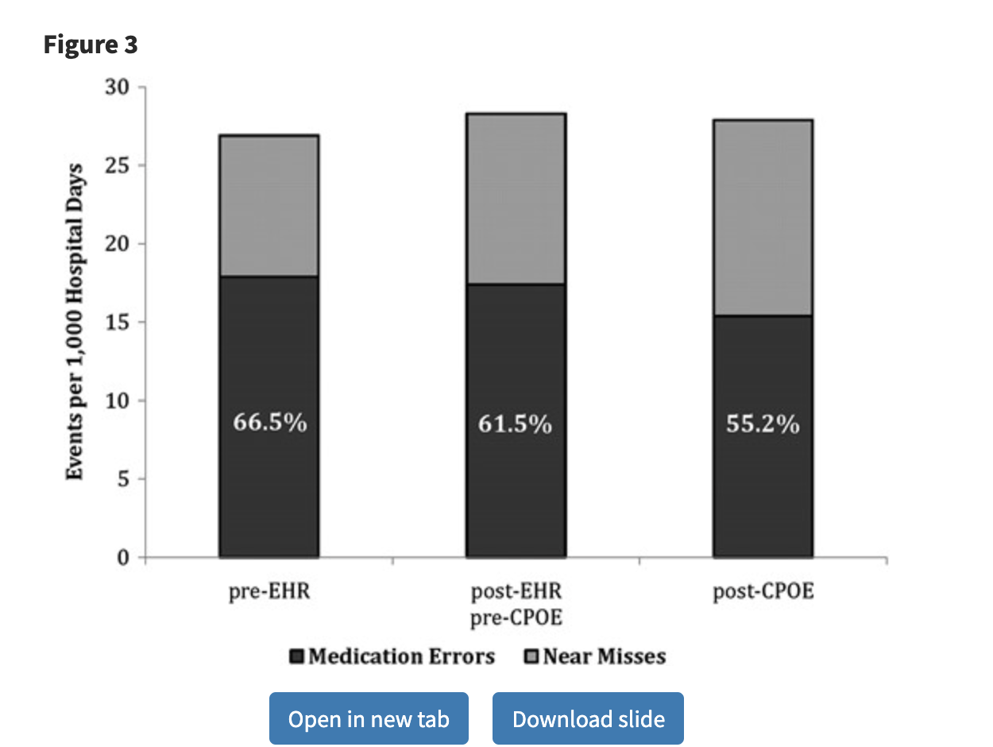
Epic at Gundersen Lutheran Medical Center
Reduced medical error rates
Medication errors per 1000 hospital days decreased from 17.9 to 15.4 (14.0%; p<0.030)
Near misses per 1000 hospital days increased from 9.0 to 12.5 (38.9%; p<0.037).
The percentage of medication events that were medication errors decreased from 66.5% to 55.2% (p<0.007).
https://www.gundersenhealth.org/
our-system/news/logos/

Slide 18
Epic at Gundersen Lutheran Medical Center
Reduce hospital expenses
Monthly transcription costs declined from $74 596 to $18 938 (74.6%; p<0.001).
Reams of copy paper ordered per month decreased from 1668 to 1224 (26.6%; p<0.001).
$55,658
444paper/mo.
SAVED
SAVED
https://www.gundersenhealth.org/
our-system/news/logos/

Slide 19

The Future of EHR
Big Data & AI
Interoperability
EHR

Slide 20


The Future of EHR: Challenges & Solutions
Big Data & AI
Main Challenges in EHR
Lack of Standardization in Data
Customized EHR systems – hard to convert to a standard format for data sharing and analysis
Burdens in Recordkeeping
Need for a smooth workflow from data collection to maintenance
Security & Consent
Increasing health information flows between system leads to security concerns
Unclear when consent is needed
Data integration & Transformation of healthcare big data into actionable knowledge.
Interoperability
The ability of a system to seamlessly exchange and use electronic health information from other systems.

Slide 21

The Future of EHR — Big Data & AI
Data Mining
Data Application & Integration
Pharmacovigilance (drug safety):
EHR record + Machine learning → predict adverse effects
Phenotyping:
EHR helps identify specific phenotypes within diseases
Natural Language Processing:
Extract and structure language for EHR data secondary use studies
Clinical Decision support:
EHR to assist clinicians in making diagnoses and preventing errors
Personal Monitoring
Wearable devices & mobile health technology + Health record in EHR = Wise Treatment
Efficient recordkeeping
Deeper use of health data
Better health outcomes

Slide 22

The Future of EHR — Interoperability
Standards Framework in Healthcare Data
Cloud Environments & Blockchain for Data Storage
Higher efficiency:
Shorten the process of verification
Data Authority:
Enable patients/assigned healthcare provider to control data releasing
Security:
Secure and decentralized manner
e.g., Fast Healthcare Interoperability Resources
Function: standardize healthcare data
Outcome: easier to move from one system to another
Better Care Coordination
Higher Performance
Better Experience
Clinicians have easy accesses to patient’s info
Fewer repeat tests, adverse effects, miscommunication
Data-driven improvements in patient care & health system
Reduce redundant administration
Satisfying experience for employee and patients
Notes:
Another trend is “interoperability”. Simply speaking, it means “Timely and secure access, and use of electronic health data between EHR systems.”
Two elements are essential to interoperability
First is the standards framework for healthcare data. Specifically, some new resources have been developed to standardize data recorded in different EHR systems and therefore make it easier to exchange and access the data
Second is the implementation of cloud environments and blockchain in data storage. By using these technologies, there will be higher efficiency in data access, more user autonomy since patient will have control over their records and also record releasing, and last but not least, higher security over their data.
As a result of achieving interoperability, we can expect better care coordination with less repeat tests or miscommunication, higher health care performance based on data, and better experience for both health providers and the patients (or the clients).

Slide 23

The Prospect of EHR
01
02
03
04
Consistently Integrating Big Data & AI
Initial Movement in Interoperability
Interoperability in Electronic Health Information
Secured Data Storage & Sharing Empowered by Blockchain
More efficient diagnose and healthcare administration process
&
Increase financial incomes for the healthcare organization/agencies

Slide 24
References
Compare EHR Price. (2021). Cloudflare. https://www.g2.com/compare/epic-vs-meditech-expanse
Definitive Healthcare. (2022). 10 most common inpatient EHR systems by market share. https://www.definitivehc.com/blog/most-common-inpatient-ehr-systems
Early cost and safety benefits of an inpatient electronic health record,Jonathan A Zlabek, Jared W Wickus, Michelle A Mathiason,(February 2011)https://academic.oup.com/jamia/article/18/2/169/802487?login=true
ELECTRONIC MEDICAL RECORDS SYSTEM IMPLEMENTATION AT STANFORD HOSPITAL AND CLINICS(2010)
Global Electronic Health Records Market Outlook (2022-2032)ve. Imaging Technology News. (2022, April 22). Retrieved July 18, 2022, from https://www.itnonline.com/content/global-electronic-health-records-market-outlook-2022-2032#:~:text=April%2022%2C%202022%20%E2%80%94%20According%20to,a%20value%20of%20%2441.8%20billion.
How much EHR costs and how to set your budget. (2021). Ehrinpractice.
https://www.ehrinpractice.com/ehr-cost-and-budget-guide.html
Interoperability in Healthcare. IBM. (n.d.). Retrieved July 15, 2022, from https://www.ibm.com/topics/interoperability-in-healthcare#:~:text=What%20is%20interoperability%20in%20healthcare,outcomes%20for%20individuals%20and%20populations
Ross, M. K., Wei, W., & Ohno-Machado, L. (2014). "Big data" and the electronic health record. Yearbook of medical informatics, 9(1), 97–104. https://doi.org/10.15265/IY-2014-0003

Slide 25
Thank You!

